Slide 1
What you will learn ?
Lambda Expressions
Functional Interface and Predefined Functional Interfaces
Method References and Types Of Method References
Optional Class to Avoid NullPointerExceptions
Default and Static Methods in Interfaces
Stream API – filter, map, sorting, finding, collecting

Slide 2
Chapter 1: Lambda Expressions

Slide 3
Lambda Expression
Lambda expression were introduced in Java 8
Lambda expression is an anonymous function. It’s a function without name and does not belongs to any class
Lambda expression is mainly used to implement functional interfaces.

Slide 4
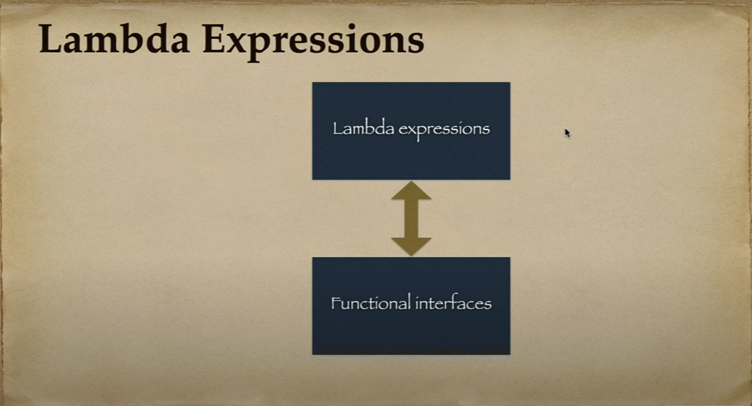

Slide 5
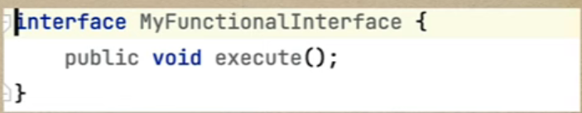
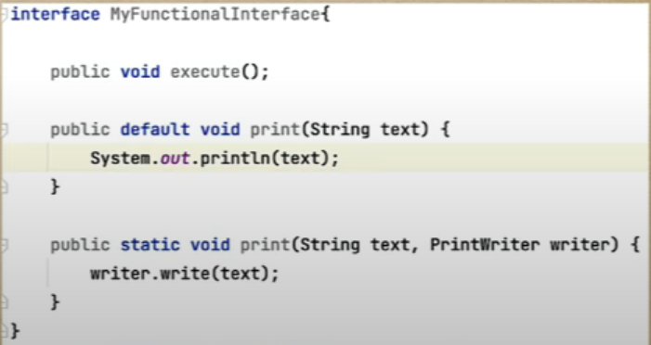
Functional Interfaces
Functional interfaces were introduced in Java 8
An Interface that contains exactly one abstract method is known as a functional interface.
Functional interface can have any number of default, static method but can contain only abstract method.
We use Java 8 provides the @FuntionalInterface annotation to mark an interface as a Functional Interface.

Slide 6
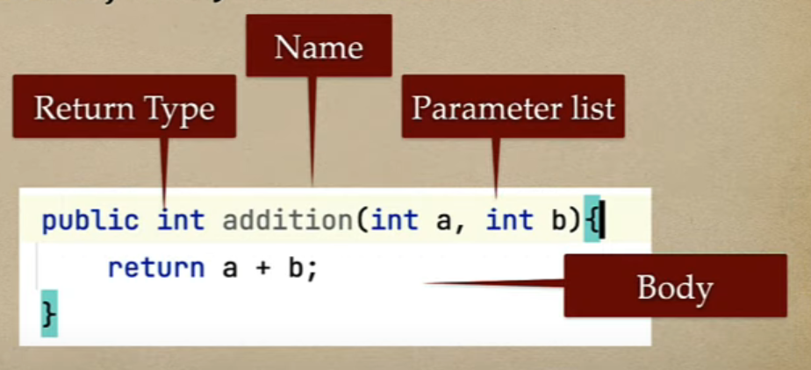
Lambda vs Method
Method is always belongs to class or object in Java where as Lambda does not belongs to any class or object
Method has the main parts:
Name
Parameter list
Body
Return Type

Slide 7
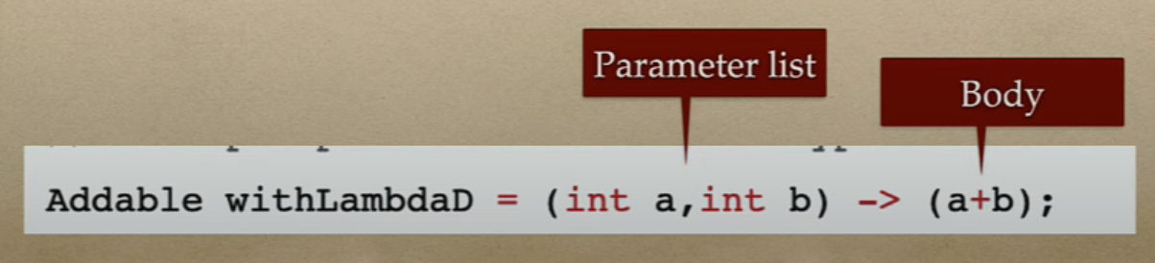
Lambda vs Method
Lambda expressions in java has these main parts:
No name – As Lambda is an anonymous function so no need to have a name
Parameter list
Body – This is the main part of the function
No Return Type – You don’t need mention the return type in the lambda expression. The Java 8+ complier is infer the return type by checking the code.

Slide 8
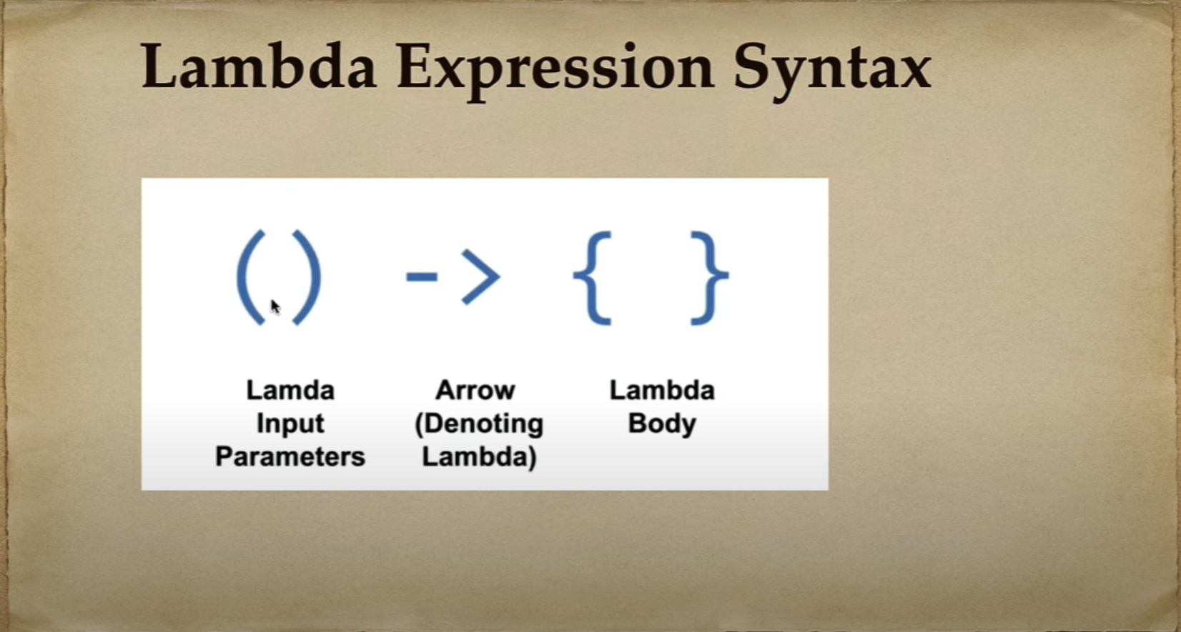

Slide 9
Chapter 2 Functional Interfaces

Slide 10
What you will learn ?
What is functional Interface with example
How to define functional interface using @FunctionalInterface annotation
How to use Lambda expression to implement functional interface
We will see some predefined functional interfaces with examples
Runnable functional interface example

Slide 11
Chapter 3
Method References

Slide 12
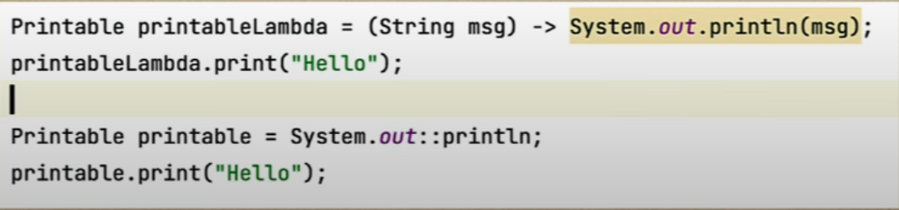
Method References
Java provides a new feature called method references in Java 8.
Method references is used to refer method of the functional interface. It is a compact and easy form of lambda expression.
Each time when you are using a lambda expression to just referring a method, you can replace your lambda expression with a method reference.

Slide 13
Types of Method References
There are four types of method references in Java:
Method reference to static method: its syntax is Class::StaticMethodName
Reference to an instance method of a particular object : the syntax is Object::instanceMethodName
Reference to an instance method of an arbitrary object of specific type : the syntax is Class::instanceMethodName
Reference to a constructor: its syntax is ClassName::new

Slide 14
Chapter 4 Optional Class

Slide 15
Chapter 6 Stream API with Examples

Slide 16
Java 8 Stream API
Stream represents a sequence of object from a source, which supports aggregate operations.
Java provides a new additional package in Java 8 called java.util.stream. This package consists of classes, interfaces, and an enum to allows functional-style operations on the elements. You can use stream by importing java.util.stream package in your programs.

Slide 17
